Slide 1
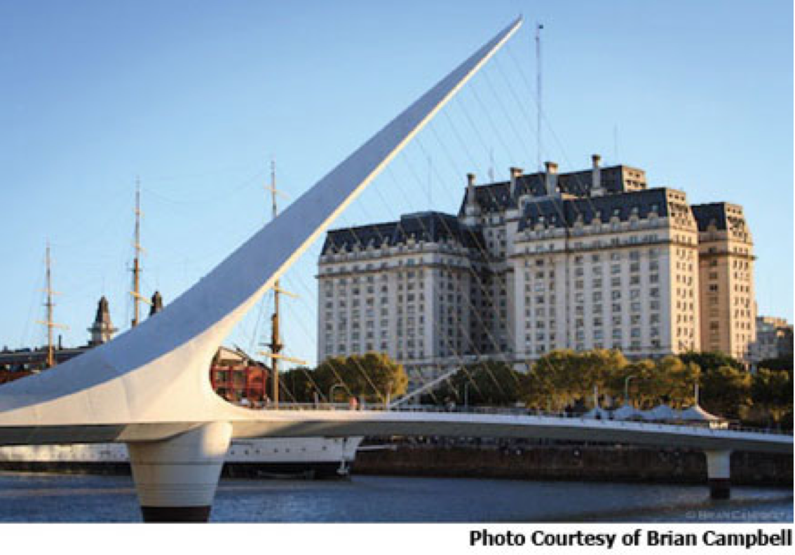

IETF Hackathon
IETF 95, April 2 – 3,
Buenos Aires, Argentina

Slide 2

Goals
Running Code (RFC 6982)
Open Source
Speed and Relevance of Standards
Collaborate and Learn
Have Fun
Cookies!
and BEER!!!

Slide 3
Note Well
Any submission to the IETF intended by the Contributor for publication as all or part of an IETF Internet-Draft or RFC and any statement made within the context of an IETF activity is considered an "IETF Contribution". Such statements include oral statements in IETF sessions, as well as written and electronic communications made at any time or place, which are addressed to:
The IETF plenary session
The IESG, or any member thereof on behalf of the IESG
Any IETF mailing list, including the IETF list itself, any working group or design team list, or any other list functioning under IETF auspices
Any IETF working group or portion thereof
Any Birds of a Feather (BOF) session
The IAB or any member thereof on behalf of the IAB
The RFC Editor or the Internet-Drafts function
All IETF Contributions are subject to the rules of RFC 5378 and RFC 3979 (updated by RFC 4879).
Statements made outside of an IETF session, mailing list or other function, that are clearly not intended to be input to an IETF activity, group or function, are not IETF Contributions in the context of this notice. Please consult RFC 5378 and RFC 3979 for details.
A participant in any IETF activity is deemed to accept all IETF rules of process, as documented in Best Current Practices RFCs and IESG Statements.
A participant in any IETF activity acknowledges that written, audio and video records of meetings may be made and may be available to the public.

Slide 4
IPR and Code Contribution Guideline
Hackathon participants free to work on any code
Rules regarding that code are what each participant's organization and/or open source project says they are
The code itself is NOT an IETF contribution
Discussions, presentations, and demos done as part of the hackathon are the same type of IETF contributions as those made in working groups; therefore, the usual IETF copyright and/or IPR disclosure rules apply

Slide 5
Technologies
DNS / DNSSEC / DANE / DNS-over (D)TLS
IBNEMO – Intent Based Network Modeling
Network Based Metrics Analysis
NETCONF/YANG, I2RS, OpenDaylight
NETVC
FD.io/VPP (Vector Packet Processing)
TLS 1.3
SCTP

Slide 6
Collaborate on Code https://github.com/eckelcu/ietf-hackathon
Git/GitHub commonly used for open source projects
Getting started:
Install Git on laptop https://help.github.com/articles/set-up-git/
Join Hackathon repo https://github.com/eckelcu/ietf-hackathon
Fork a project, or the repo, to work on an existing project or add a new one https://help.github.com/articles/fork-a-repo/
“Follow” team members and “watch” project(s) https://help.github.com/articles/be-social/
More info: http://gitref.org

Slide 7
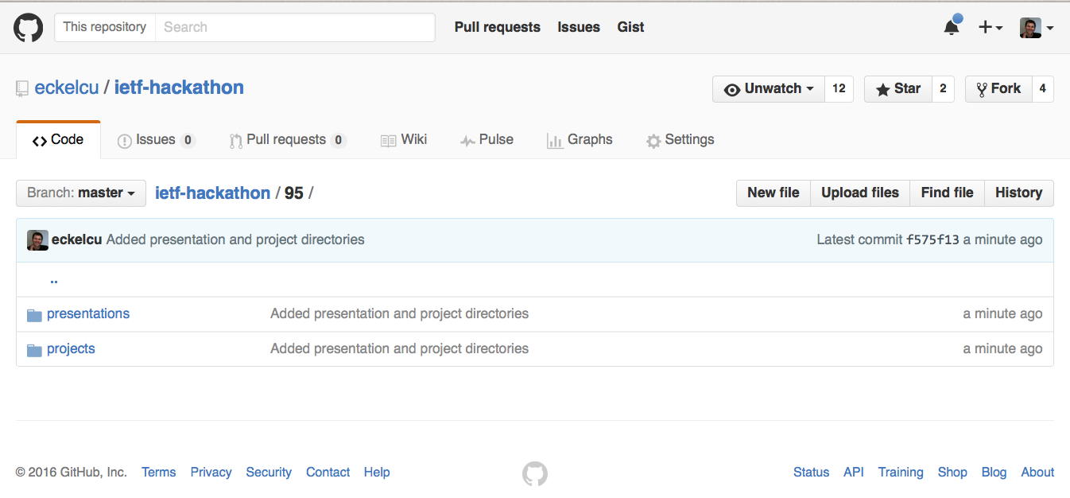
https://github.com/eckelcu/ietf-hackathon/95

Slide 8

Agenda - Saturday
09:00: Room opens - Pastries and coffee
09:30: Hackathon kickoff - Intro to all technologies by champions, form teams
12:30: Lunch
15:30: Afternoon break - Snacks provided
18:30: Progress check and sharing
19:00: Dinner
22:00: Room closes and is locked

Slide 9

Agenda - Sunday
09:00: Room opens - Pastries and coffee
12:30: Lunch
13:30: Hacking stops, prepare brief presentation of project
14:00: Project presentation to other participants and judges
15:00: Recap and suggestions for improvements
15:30: Awards presented, prizes given
16:00: Hackathon ends

Slide 10
Judging Criteria
Advance pace and relevance of IETF standards
Bring speed and collaborative spirit of open source software into the IETF
Flush out ideas, feed into WG session
Produce sample code/reference implementations
Create useful utilities
Attract developers, young people to IETF
There’s cool shit at IETF
#IETFhackathon, #IETF95

Slide 11

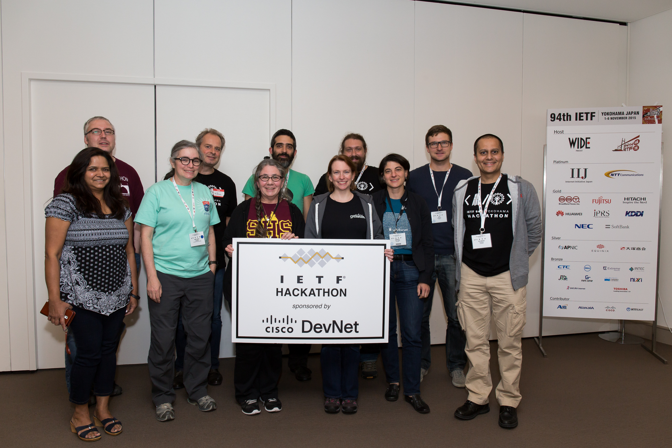
Prizes

Slide 12
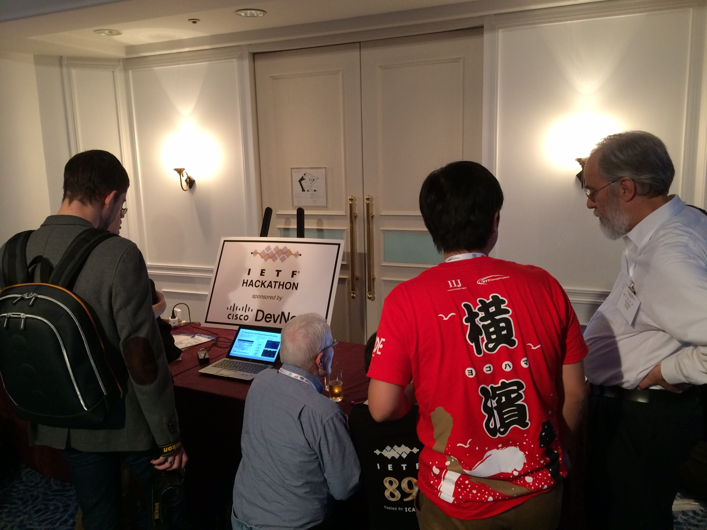
Bits-N-Bites
Table for Hackathon Projects
Show off what you did
Thursday, 19:45– 21:45
Pacifico B
Bits-N-Bites
Food and drinks provided

Slide 13
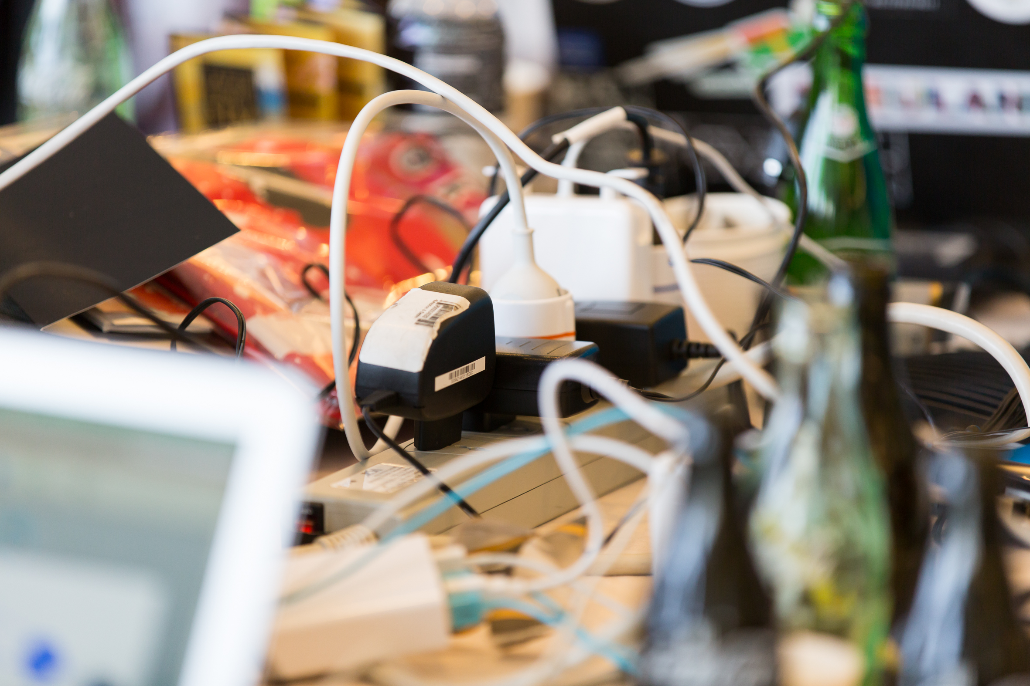
#IETFhackathon Photo Contest
Best IETF Hackathon Photo
Post to Twitter
#IETFhackathon
#IETF95

Slide 14
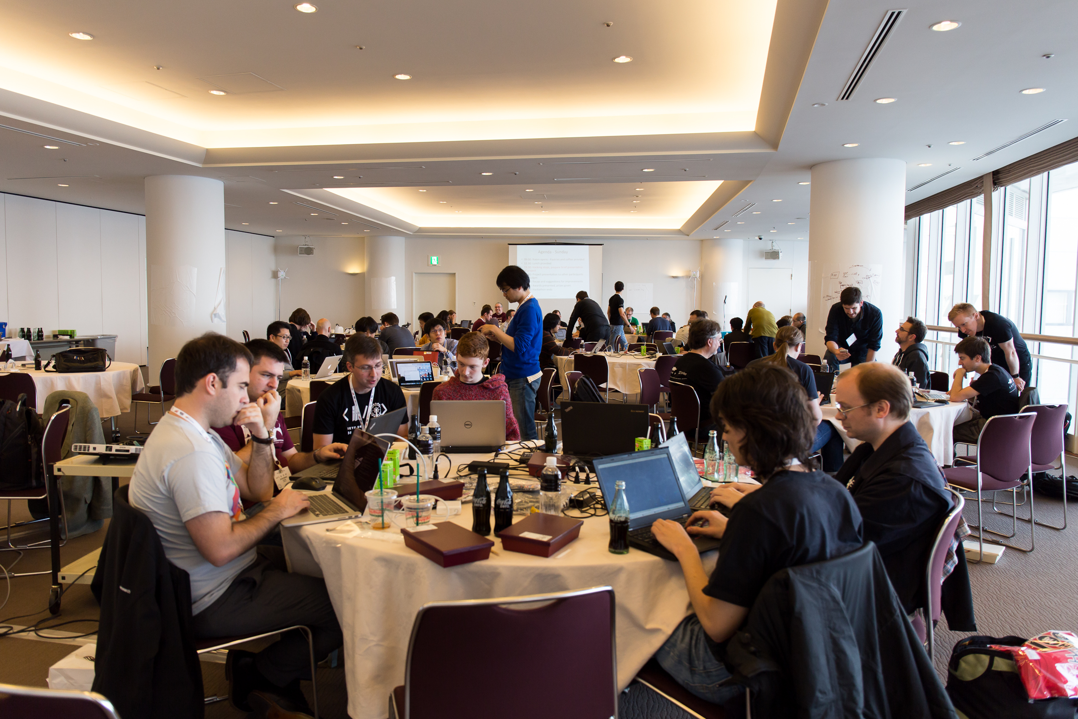
Let’s Get Hacking!

